Slide 1
CAN

Slide 2
Introduction
The Controller Area Network (CAN) is a serial bus communications protocol developed by Bosch
By networking the electronics in vehicles with CAN, however, they could be controlled from a central point, the engine control unit (ECU), thus increasing functionality, adding modularity, and making diagnostic processes more efficient.

Slide 3
Contd.
Today the CAN protocol is used in many other fields in applications that call for networked embedded control, including industrial automation, medical applications, building automation, weaving machines, and production machinery.
CAN offers an efficient communication protocol between sensors, actuators, controllers, and other nodes in real-time applications, and is known for its simplicity, reliability, and high performance

Slide 4
Contd.
The CAN protocol is based on a bus topology, and only two wires are needed for communication over a CAN bus.
The bus has a multimaster structure where each device on the bus can send or receive data.

Slide 5
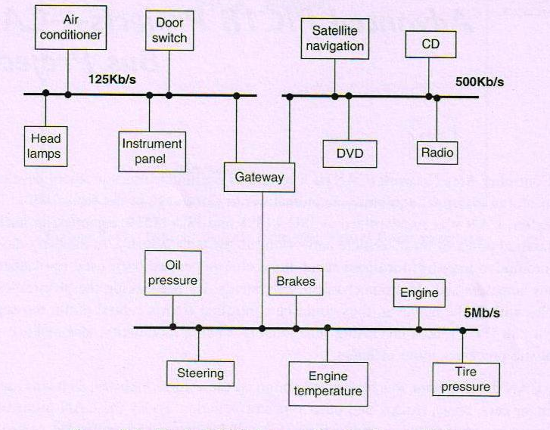
Contd.

Slide 6
Contd.
Figure 1 shows a typical vehicle application there is usually more than one CAN bus, and they operate at different speeds.
Slower devices, such as door control, climate control, and driver information modules, can be connected to a slow speed bus.
Devices that require faster response, such as the ABS antilock braking system, the transmission control module, and the electronic throttle module, are connected to a faster CAN bus.

Slide 7
Contd.
Current estimate is that 400 million CAN modules are sold every year, and CAN controllers are integrated on many microcontrollers, including PIC microcontrollers, and are available at low cost

Slide 8
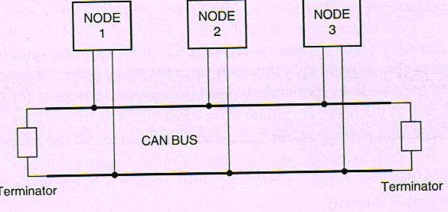
nodes

Slide 9
Contd.
The CAN protocol is based on CSMA/CD +AMP (Carrier-Sense Multiple Access /Collision Detection with Arbitration on Message Priority) protocol
CAN protocol, however, solves the collision problem using the principle of arbitration, where only the highest priority node is given the right to send its data.

Slide 10
Contd.
Two types of CAN protocols: 2.0A and 2.0B.
CAN 2.0A is the earlier standard with 11 bits of identifier, while CAN 2.0B is the new extended standard with 29 bits of identifier.
Two types of 2.0A controllers.
The first is capable of sending and receiving 2.0A messages only, and reception of a 2.0B message will flag an error. The second type of 2.0A controller (known as 2.0B passive) sends and receives 2.0A messages but will also acknowledge receipt of 2.0B messages

Slide 11
2.0A and 2.0B
SOF | 11 bit identifier | RTR
SOF | 11 BIT IDENTIFIER | SRR | IDE | 18 BIT IDENTIFIER | RTR
This (high) part of the identifier field is called the Base ID and provides the
‘base priority’ of the extended frame.
RTR: remote transmission request bit,
SSR: substitute remote request bit,
IDE: identifier extension bit.

Slide 12
Features
CAN bus is multimaster. When the bus is free, any device attached to the bus can start sending a message.
CAN bus protocol is flexible. The devices connected to the bus have no addresses, which means messages are not transmitted from one node to another based on addresses

Slide 13
Contd.
CAN bus offers remote transmit request (RTR), which means that one node on the bus is able to request information from the other nodes
CAN bus communication speed is not fixed.
All devices on the bus can detect an error.
Multiple devices can be connected to the bus at the same time, and there are no logical limits to the number of devices that can be connected

Slide 14
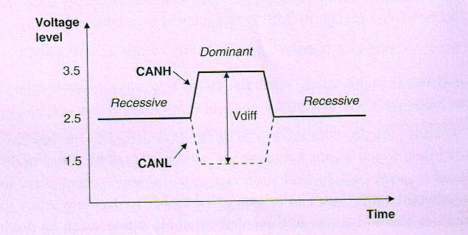
CAN logic states

Slide 15
Contd.
Dominant and recessive states
The bus defines a logic bit 0 as a dominant bit and a logic bit 1 as a recessive bit.
In the recessive state, the differential voltage CANH and CANL is less than the minimum threshold. In the dominant state, the differential voltage CANH and CANL is greater than the minimum threshold.

Slide 16
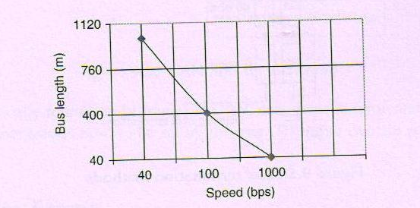
Contd.
The ISO-11898 CAN bus specifies that a device on that bus must be able to drive a forty-meter cable at 1Mb/s.

Slide 17
Contd.
A CAN bus is terminated to minimize signal reflections on the bus.
Standard termination
Split termination
Biased split termination

Slide 18
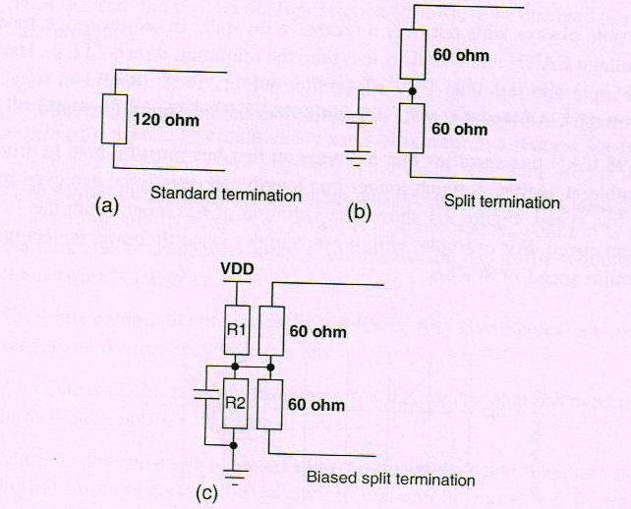
Terminations

Slide 19
Contd.
In standard termination, the most common termination method, a 120-ohm resistor is used at each end of the bus
In split termination, the ends of the bus are split and a single 60-ohm resistor is used.
Split termination allows for reduced emission, and this method is gaining popularity.
Biased split termination is similar to split termination except that a voltage dividercircuit and a capacitor are used at either end of the bus

Slide 20
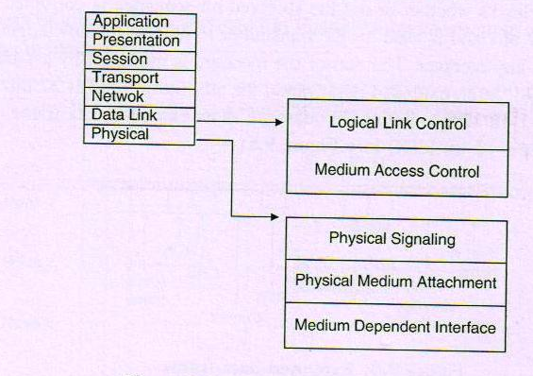
CAN and the OSI model

Slide 21
CAN and the OSI model
The CAN protocol includes the data link layer, and the physical layer of the OSI reference model
The data link layer (DLL) consists of the Logical Link Control (LLC) and Medium Access Control (MAC).
LLC manages the overload notification, acceptance filtering, and error recovery management.
MAC manages the data encapsulation, frame coding, error detection, and serialization/deserialization of the data.
The physical layer consists of the physical signaling layer (PSL), physical medium attachment (PMA), and the medium dependent interface (MDI).

Slide 22
Contd.
The physical layer specifies the way in which the signal is transmitted, and therefore it has the role of ensuring the physical transfer of bits between the different nodes, according to all the properties (electrical, electronic, optical, etc.) of the system.
Clearly, the physical layer must be the same for each node within a single network.
this layer is responsible for
bit representation (coding, timing, etc.),
bit synchronization,
definition of the electrical and optical levels of the signals,
definition of the transmission medium.

Slide 23
Bit stuffing
The CAN bus makes use of bit stuffing, a technique to periodically synchronize transmit-receive operations to prevent timing errors between receive nodes
After 5 consecutive bits with the same level, one bit of inverted data is added to the sequence
If, during sending of a data frame or remote frame, the same level occurs in 5 consecutive bits anywhere from the start of frame to the CRC sequence, an inverted bit is inserted in the next (i.e., the sixth) bit

Slide 24
Contd.
If, during receiving of a data frame or remote frame, the same level occurs in 5 consecutive bits anywhere from the start of frame to CRC sequence, the next (sixth) bit is deleted from the received frame
If the deleted sixth bit is at the same level as the fifth bit, an error (stuffing error) is detected

Slide 25
Contd.
The hardware of the integrated circuits makes this bit ‘overcoding’ method completely transparent to the user, but signals any errors if they happen to occur
provides a greater ease of bit synchronization
only the fragments of frames relating to the start of frame, arbitration field, control field, data field and CRC sequence are coded by the bit stuffing method.

Slide 26
Contd.
The remaining bits of the other segments of the data frames or remote frames, such as the CRC delimiter, ACK field and end of frame, have fixed structures and are not stuffed.
the error frames and overload frames also have fixed structures and therefore are not coded by the bit stuffing method

Slide 27
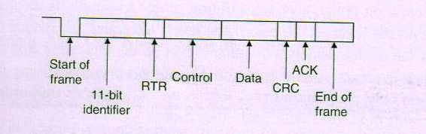
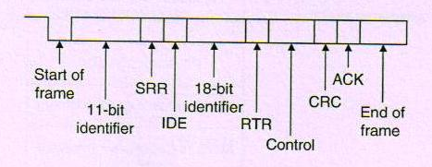
Frames
CAN 2.0A
CAN 2.0B

Slide 28
Frames
There are basically four message frames in CAN: data, remote, error, and overload.
data frames, which transport the data from the senders to the receivers;
remote frames, sent by a unit active on the bus to request the transmission of a data frame whose identifier has the same value as that of the remote frame;
error frames, transmitted by any of the units present on the bus as soon as an error is detected on the bus;
overload frames, used to request a supplementary time interval between the preceding and following data frames or remote frames;
interframes, which separate (in time) the data frames and remote frames from the preceding frames by an interframe space.
For the bit stream of the CAN bus frames, the NRZ coding method has been adopted.

Slide 29
Data Frame
Standard and extended
The data frame is used by the transmitting device to send data to the receiving device
A standard data frame starts with the start of frame (SOF) bit, which is followed by an 11-bit identifier and the remote transmission request (RTR) bit
The control field is 6 bits wide and indicates how many bytes of data are in the data field.
The data field can be 0 to 8 bytes.

Slide 30
Contd.
CRC field, which checks whether or not the received bit sequence is corrupted.
The ACK field is 2 bits and is used by the transmitter to receive acknowledgment of a valid frame from any receiver. The end of the message is indicated by a 7-bit end of frame (EOF) field.

Slide 31
Contd.
SOF-The start of frame of the data frame consists of a single dominant bit, signalling to all receivers the start of an exchange. This exchange can start only if the bus has been idle so far.
Arbitration Field-Arbitration is used to resolve bus conflicts that occur when several devices at once start sending messages on the bus

Slide 32
Contd.
Standard format there are 11 bits, and up to 2032 IDs can be set
extended format-ID consists of 11 base IDs plus 18 extended IDs and 2032 218 discrete IDs
In a data frame, the RTR bit must be dominant.
During the arbitration phase, each transmitting device transmits its identifier and compares it with the level on the bus.
If the levels are equal, the device continues to transmit. If the device detects a dominant level on the bus while it is trying to transmit a recessive level, it quits transmitting and becomes a receiving device

Slide 33
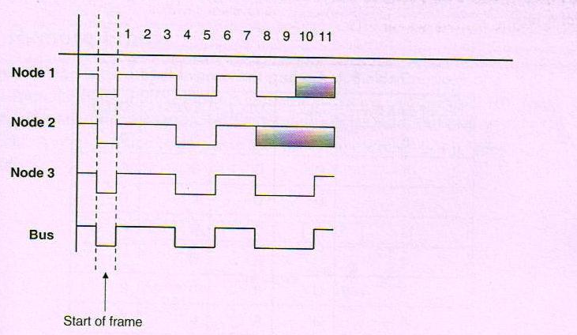
example
Node 1: 11100110011 Node 2: 11100111111 Node 3: 11100110001

Slide 34
Contd.
All the nodes start transmitting simultaneously, first sending SOF bits.
Then they send their identifier bits. The 8th bit of Node 2 is in the recessive state, while the corresponding bits of Nodes 1 and 3 are in the dominant state.
Therefore Node 2 stops transmitting and returns to receive mode. The receiving phase is indicated by a gray field.
The 10th bit of Node 1 is in the recessive state, while the same bit of Node 3 is in dominant state.
Thus Node 1 stops transmitting and returns to receive mode.
The bus is now left to Node 3, which can send its control and data fields freely.

Slide 35
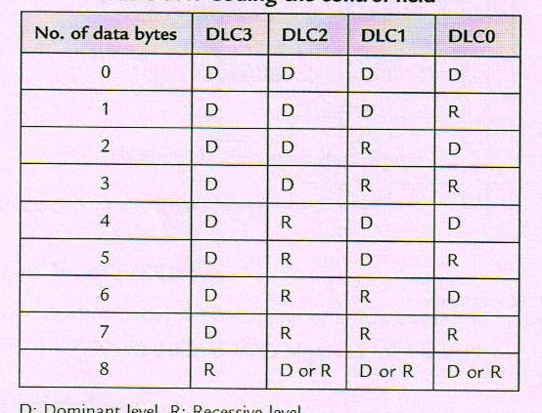
Control Field

Slide 36
Contd.
The control field is 6 bits wide, consisting of 2 reserved bits and 4 data length code(DLC) bits, and indicates the number of data bytes in the message being transmitted.
Reserved bits
The first two bits (sent as dominant in the 2.0A frame) are reserved for later use and ensure future upward compatibility (particularly that of the frame known as the extended CAN2.0B frame). CAN controllers must be capable of handling all the combinations of all the bits of the control field.

Slide 37
Data Field
The data field carries the actual content of the message. The data size can vary from0 to 8 bytes. The data is transmitted with the MSB first.

Slide 38
CRC Field
The CRC field, consisting of a 15-bit CRC sequence and a 1-bit CRC delimiter, is used to check the frame for a transmission error.
The CRC calculation includes the start of frame, arbitration field, control field, and data field.
The calculated CRC and the received CRC sequence are compared, and if they do not match, an error is assumed

Slide 39
Contd.
The CRC sequence is determined (calculated) by the sender of the message, using the
following procedure:
(a) The stream of bits (not stuffed or destuffed), consisting of the bits from the start of the frame to the end of the data field (if present), is interpreted as a polynomial f(x) with coefficients 0 and 1 assigned to the actual presence or absence of each bit. The polynomial obtained in this way is then supplemented with zeros for the 15 least significant coefficients.
(b) The above polynomial formed in this way is divided, modulo 2, by the following generating polynomial, including a parity check:

Slide 40
Contd.
G(X)= X15+ X14+ X10 + X8+ X7+ X4+ X3+ 1 or transcribed into the following binary form:
G(X)= 1100010110011001:
(c) After the division of the polynomial f(x) by the generating polynomial g(x), the rest of this ‘polynomial division’ forms the 15-bit CRC sequence. The last-mentioned item is transmitted in the CRC field during the CRC sequence.

Slide 41
ACK Field
The ACK field indicates that the frame has been received normally.
This field consists of 2 bits, one for ACK slot and one for ACK delimiter.
ACK slot:
Whenever a receiver present in the network has correctly received a message – in the sense of ‘no transmission error’ (including the CRC) – the received message then being considered as valid, it acknowledges this to the sender by substituting a dominant bit in the ACK slot time slot for the recessive bit that has been present until this moment. It then sends an ‘acknowledgement’, ACK.

Slide 42
Contd.
ACK delimiter
This second bit must (always) be recessive, and therefore when a message has been correctly received by all the stations present in the network, the ACK slot (dominant) bit is surrounded by two recessive bits (CRC delimiter and ACK delimiter).

Slide 43
End of data frame
The data frame is terminated by a flag consisting of a sequence of 7 recessive bits, which, is 2 bits longer than the bit stuffing standard length.
This field has a fixed structure, and the bit stuffing logics for coding (in sending) and decoding (in receiving) are disabled during the end of frame field sequence.

Slide 44
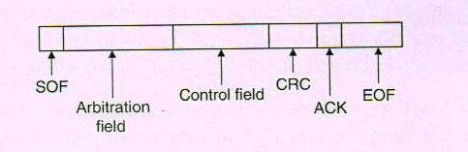
Remote Frame
The remote frame is used by the receiving unit to request transmission of a message from the transmitting unit. A remote frame is the same as a data frame except that it lacks a data field.

Slide 45
Contd.
the start of frame,
the arbitration field,
the control field,
the CRC field,
the acknowledgement field,
the end of frame.
This is followed by a 7th area, called the inter frame space.

Slide 46
Contd.
RTR bit-this bit is recessive in a remote frame. for a single identifier, a data frame always takes priority over a remote frame
Control field: The last 4 bits indicate the number of bytes in the data field; in other words, those not contained in the remote frame ,but which the data frame will be responsible for recovering subsequently

Slide 47
Errors
Many types of errors can occur
Bit errors are detected when the output level and the data level on the bus do not match. Both transmit and receive units can detect bit errors
bit stuffing error -Stuffing errors are detected when the same level of data is detected for 6 consecutive bits in any field that should have been bit-stuffed. This error can be detected by both the transmitting and receiving units
Form error-illegal frame format is detected.
– the fact that all is well at the level of the bit and the frame structure, but that, for example, the frame has not been acknowledged, causing an ACKnowledgement error,
- the CRC value is not what was expected-CRC error; CRC errors are detected only by receiving units.

Slide 48
Contd.
in the frame layer, in the sense that its internal structure has been violated (information in the
wrong place, etc.), the following errors can occur:
– CRC delimiter error,
– Acknowledgement delimiter error,
– end of frame error,
– error delimiter error,
– overload delimiter error.

Slide 49
Contd.
All microcontrollers conforming to the CAN protocol must have two quite separate internal counters, the ‘transmit error counter’ and the ‘receive error counter’, with the task of recording (counting) the errors occurring in transmission and reception, respectively
if the message is correctly transmitted or received, the counter in question is decremented;
if the message contains errors, the counter in question is incremented

Slide 50
Contd.
When the values of the two error counters are in the range from 0 to 127, the CAN station (or node) is said to be operating in the ‘error active’ state (mode).
This means that the node in question will not only continue to receive and send normally, but also transmit an ‘active error flag’ in the error frame if an error is detected

Slide 51
Contd.
When the values of one or other of the two error counters are in the range from 128 to 255, the, CAN station (or node) is said to be operating in the ‘error passive’ state (mode).
This means that the node in question will continue not only to receive and send normally, but also transmit ‘passive error flags’ only in the error frame if an error is detected

Slide 52
Contd.
If the transmission counter value exceeds 255 (256), the CAN station (node) is said to have entered the ‘bus off’ state (mode).
This means that the node in question, becoming tired of being unable to receive or transmit messages successfully, goes off to sulk in a corner and stops receiving and sending normally.

Slide 53
Contd.
The CAN protocol uses the following error detection mechanisms:
bus monitoring, cyclic redundancy check, message frame check, bit stuffing, acknowledgement, error signalling.
Bus monitoring. The bit sender compares the signal it wishes to send with the signal that it physically observes on the physical line of the bus. If the signal present on the bus is different from the sent signal, the sender then sends an error frame, except in the case of the arbitration phase (during the transmission of the message identifier) and the ACK slot
Cyclic redundancy code – CRC. The 15 CRC bits are calculated from each bit of the SOF up to the last data bit.

Slide 54
Contd.
Frame check message. The SOF, RTR, IDE, DLC, and EOF fields and the delimiters must be consistent with the CAN specification. If one of the fixed-format fields of the received frame (except the last bit of the EOF) does not conform to the standard, the receiver sends an error frame and does not accept the received frame.
Bit stuffing. A violation of the bit stuffing rule between the SOF and the CRC must be considered as an error.
Acknowledgement. The sender of a data frame or remote frame treats an absence of acknowledgement as an error and destroys the EOF field, sending an error frame.
Error signalling. Each station detecting an error starts an error frame so that the other stations present in the network see a violation of the bit stuffing rule, or of the fixed format of the delimiters, or of the EOF fields.

Slide 55
Contd.
In the case of
– a bit error,
– a bit stuffing error,
– a structure error,
– an acknowledgement error,
the transmission of an error flag starts simultaneously with the next bit, from the station which has detected the error.
Whenever a station detects a CRC error, the transmission of an error flag starts with the bit following the ACKnowledge delimiter, unless an error flag for another error condition has already been started elsewhere in the network.

Slide 56
Error Frame
Error frames are generated and transmitted by the CAN hardware and are used to indicate when an error has occurred during transmission.
An error frame consists of an error flag and an error delimiter.
There are two types of error flags: active, which consists of 6 dominant bits, and passive, which consists of 6 recessive bits.
The error delimiter consists of 8 recessive bits.
Error flag | Error delimiter

Slide 57
Contd.
An error active station detecting an error condition signals this by transmitting an active error flag
all the other stations present on the network also detect an error condition and also start the transmission of a new error flag
Passive error flag-A station which is said to be error passive and which detects an error condition ‘tries’ to signal this by transmitting a passive error flag.
According to the principle of recessive bit transmission, a passive error flag cannot interrupt a current message between other different controllers present on the bus, but this type of error flag can be ignored (‘squashed’) by the other controllers.

Slide 58
Contd.
Error delimiter
The error delimiter consists of 8 recessive bits.
After the transmission of an error flag, each station ‘sends’ recessive bits and examines (monitors) the bus, until it detects a change from a dominant level to a recessive level.
At this instant, each CAN controller has finished transmitting its error flag and has additionally sent the first of the error delimiter bits.
All the CAN controllers are then able to start the sequence of the remaining 7 recessive bits, to finish the construction of the 8 bits of the error delimiter.

Slide 59
Contd.
After this event and an intermission field, all the ‘error active’ controllers present on the network can start a transmission simultaneously.
If a detected error is signalled during the transmission of a data frame or a remote frame, the current message is destroyed and a retransmission of the message is initialized.
If a CAN controller recognizes a frame error, a new error frame will be transmitted.
Several consecutive error frames can make the CAN controller become ‘error passive’ and leave the network unblocked

Slide 60
Overload Frame
The overload frame is used by the receiving unit to indicate that it is not yet ready to receive frames.
This frame consists of an overload flag and an overload delimiter.
it can appear at the end of a frame or of an error delimiter, or at the end of another overload delimiter in place of the start of the interframe.
It is followed by the area called the interframe space, or by another overload frame.

Slide 61
Contd.
There are two kinds of overload condition leading to the transmission of an overload flag
the internal conditions of a receiver which require a certain time (a delay) for the acceptance of the next data frame or remote frame. In this case, the start of an overload frame is allowed
only in the first time bit of the anticipated intermission; the detection of a dominant bit during the intermission phase. In this case, the start of the overload frame occurs immediately after the detection of the dominant bit.

Slide 62
Contd.
Overload flag field
This consists of 6 consecutive dominant bits, like its counterpart the active error flag. The structure of the OLF destroys the defined structure of the intermission field.
All the other stations then detect an overload condition, and each starts to transmit an OLF on its own account. If a dominant bit is detected locally in a node during the 3rd bit of the intermission, the other nodes do not interpret the OLF correctly, but interpret the first of these 6 dominant bits as a start of frame

Slide 63
Overload delimiter
the overload delimiter consists of 8 consecutive recessive bits, like its counterpart the error delimiter.
They also have the same structure.
After the transmission of an overload flag, the station examines the bus until it detects a transition signalling a change from a dominant to a recessive bit.
At this instant, each station on the bus has finished sending its overload flag, and all the stations start transmitting 7 additional recessive bits simultaneously.

Slide 64
Interframe period
The data frame and remote frame are separated from the preceding frames (regardless of their type: data, remote, error or overload frame) by a field of bits called the interframe space.
However, the overload frame and error frame are not preceded by an interframe space, and multiple overload frames are not separated by an interframe space

Slide 65
Contd.
the intermission bit field,
the bus idle bit field and
for passive error stations which have been transmitters of the preceding message, a suspend transmission bit field.

Slide 66
Contd.
Intermission field
This consists of 3 recessive bits.
During the intermission, no station is allowed to start transmitting the data frame or the remote frame. The only possible action is the signalling of an overload condition.
Bus idle field
The period for which the bus is idle (at rest, waiting) can be chosen arbitrarily. During this time, the bus (the line) is ‘free’, and any station having data to transmit can access the bus.
A message which was waiting to be transmitted during the preceding transmission can then start with the first bit following the intermission.

Slide 67
Contd.
Suspend transmission field
After an error passive station has transmitted a message, it sends 8 recessive bits following the intermission field, before starting the transmission of another message or recognizing that the bus is ‘free’.
If a transmission (from another station) starts in the same time interval, the station becomes a receiver of this message

Slide 68
Contd.
Sleep mode and wake-up
To reduce power consumption, a participant in the CAN network can switch to sleep mode; in other words it can cease to have any internal activity, having disconnected its bus drivers from the line.
The sleep mode is terminated by a wake-up caused by any activity on the bus or by the internal conditions of the local system.

Slide 69
Nominal Bit Timing
The CAN bus nominal bit rate is defined as the number of bits transmitted every second without resynchronization.
The inverse of the nominal bit rate is the nominal bit time.

Slide 70
Contd.
One message bit consists of four non overlapping time segments:
Synchronization segment (Sync_Seg)
Propagation time segment (Prop_Seg)
Phase buffer segment 1 (Phase_Seg1)
Phase buffer segment 2 (Phase_Seg2)

Slide 71
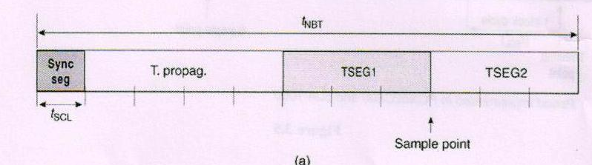
Message bit time

Slide 72
Contd.
The Sync_Seg segment is used to synchronize various nodes on the bus, and an edge is expected to lie within this segment.
The Prop_Seg segment compensates for physical delay times within the network due to the physical phenomenon of propagation of the signal on the medium used and the types of topology used to develop the geometrical configuration of networks
The Phase_Seg1 and Phase_Seg2 segments compensate for edge phase errors.

Slide 73
Phase_Seg1 and Phase_Seg2 are used to compensate for the variations, errors or changes in the phase and/or position of the edges of the signals which may occur during an exchange on the medium (due to jitter, variation of thresholds of the level detectors of the input comparators of the integrated circuits, integration and deformation of the signals along the line forming the bus, etc.).

Slide 74
Contd.
The sample point is the point in time where the actual bit value is located and occurs at the end of Phase_Seg1
To improve the quality of the capture and validation of the bit (in the presence of parasites, an arbitration phase if any, etc.), it has always been permissible to carry out digital filtering by sampling the bit value several times following the sample point instant
A CAN controller can be configured to sample three times and use a majority function to determine the actual bit value .This is what is generally called a ‘protocol enhancement’
.

Slide 75
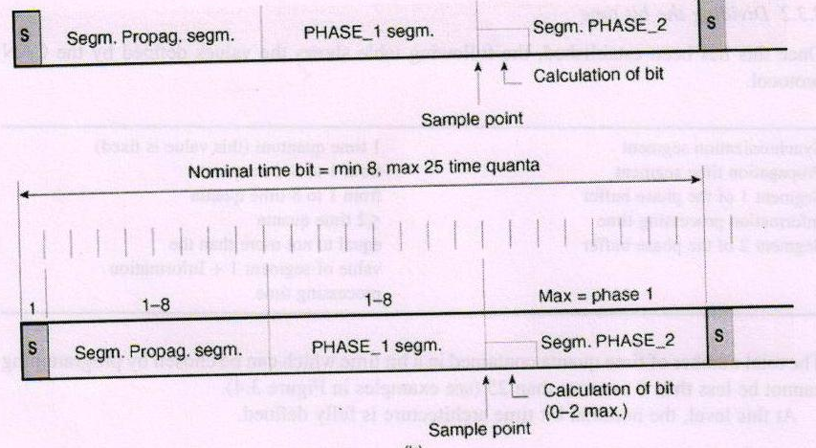
Contd.

Slide 76
Constructing the bit time
The nominal bit time of a CAN network is fixed and specified for a project, and each station must be able to construct its own nominal bit time locally using its own resources.
Each local division of nominal bit time can therefore be structurally different from one station to another.
Clearly, it is preferable for the ‘project manager’, responsible for the network design, to harmonize all the time divisions of all the individual nominal bit times.

Slide 77
Contd.
definition of the base for the construction of the bit time of a local station as the smallest reference time element usable by this station, called the ‘minimum time quantum’
Each segment is divided into units known as time quantum, or TQ. The time quantum is a fixed unit of time, derived and obtained from the minimum time quantum from which the CAN bit is to be constructed.
The actual construction of this time unit is carried out with the aid of programmable (pre-)dividers (by integers m), whose division range must extend from 1 to 32. Time quantum= m * Minimum time quantum

Slide 78
Contd.
The TQ is a fixed unit derived from the oscillator period, and the time quantum of each segment can vary from 1 to 8. The lengths of the various time segments are:
Sync_Seg is 1 time quantum long
Prop_Seg is programmable as 1 to 8 time quanta long The parameters used to determine the value of this segment are:
the medium (and its choice),
the propagation speed of the signal on this medium,
the maximum length of the network (medium),
the topology of the network,
the electrical input/output parameters of the line interface components,
the quality of the received signals, etc

Slide 79
Contd.
Phase_Seg1 is programmable as 1 to 8 time quanta long
Phase_Seg2 is programmable as 2 to 8 time quanta long
the nominal values of the clock frequencies of each node,
the tolerances of these clocks,
the temperature and time fluctuations of these clocks,
the worst cases, etc.

Slide 80
Contd.
By setting the bit timing, a sampling point can be set so multiple units on the bus can sample messages with the same timing.
The nominal bit time is programmable from a minimum of 8 time quanta to a maximum of 25 time quanta.
The minimum nominal bit time is 1ms, corresponding to a maximum 1Mb/s rate.

Slide 81
Contd.
The nominal bit time (TBIT) is given by
TBIT =TQ * (Sync_Seg + Prop_Seg + Phase_Seg1 + Phase_Seg2)
the nominal bit rate (NMR) is NBR = 1/TBIT
The time quantum can be expressed as:
TQ = 2 *(BRP + 1)/FOSC
where TQ is in ms, FOSC is in MHz, and BRP is the baud rate prescaler (0 to 63).
TQ = 2 *(BRP + 1)* TOSC

Slide 82
Bit sync.
each node has an internal oscillator which belongs to it and which operates continuously
The clock frequencies of all these nodes do not necessarily have exactly the same values (for the same nominal and theoretical bit rate of the CAN bus), either because of the strict values and tolerances, or because of the fact that the initial clocks of the different nodes are not absolutely identical

Slide 83
Contd.
Assuming that all the nodes have been made to have the same nominal clock value and the same division factors, the local clocks will never be strictly identical from one node to another, only because of the tolerances of the quartz oscillators, or, for example, because of the fluctuations due to the fact that each node operates in an environment having a substantially different temperature

Slide 84
Bit Synchronization
In order to compensate for phase shifts between the oscillator frequencies of nodes on a bus, each CAN controller must synchronize to the relevant signal edge of the received signal.
Two types of synchronization are defined: hard synchronization and resynchronization.

Slide 85
Contd.
Hard synchronization is used only at the beginning of a message frame, when each CAN node aligns the Sync_Seg of its current bit time to the recessive or dominant edge of the transmitted start of frame.

Slide 86
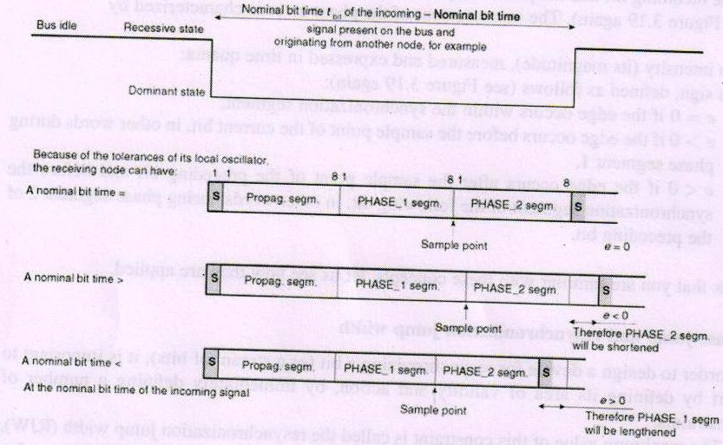
Contd.

Slide 87
Contd.
when the leading edge (transition) of the incoming bit is located – or is forced to be located – within the synchronization segment of the nominal bit time that has just started.
In short, the new bit time restarts with the synchronization segment in hard synchronization. This is in fact the equivalent of the well-known direct synchronization systems of oscilloscopes

Slide 88
Operating rules
Operating rules for the two synchronization modes:
Only one type of synchronization is permitted within a nominal bit time (hardware synchronization or resynchronization).
When the bus is inactive (in the idle state), the hardware synchronization is carried out whenever there is a transition from the recessive to the dominant state (this actually corresponds to the start of a frame).
A transition (signal edge) is used to ensure its synchronization if (and only if) the value read on the bus immediately after the transition is different from that detected at the preceding ‘sample point’ (the previously read bus value).

Slide 89
Contd.
All other transitions (from recessive to dominant, and possibly from dominant to recessive in the case of low bit rates) meeting the conditions of Rules 1 and 2 will be used for resynchronization, with the exception of the case in which a node transmitting a dominant bit does not carry out a resynchronization as the result of a transition from recessive to dominant having (or causing) a positive phase error, if only recessive to dominant transitions are used for the resynchronization.

Slide 90
Bit resynchronization
With resynchronization, Phase_Seg1 may be lengthened or Phase_Seg2 may be shortened
‘Bit resynchronization’ is a mechanism which can be used in the transmission of an isolated bit or a stream of bits of a message to compensate for either the variations of individual (instantaneous) frequencies of the CAN controllers on the network;
The changes in length of the nominal bit times introduced by switching from one transmitting station to another, for example during arbitration phases when the edges do not arrive at strictly the same instant, because of the different propagation times (or distances) of the different candidates in the arbitration procedure.

Slide 91
Contd.
The resynchronization mode exploits various new features of CAN, namely
phase errors and their associated signs,
phase jumps and the widths of phase jumps.

Slide 92
Phase error of a signal transition
The phase error e of an edge is given by the relative discrepancy in position between the edge of the incoming bit and the predicted position of the synchronization segment of the bit time.

Slide 93
Contd.
The measurement of the phase error is characterized by
its intensity (its magnitude), measured and expressed in time quanta;
its sign, defined as follows
– e = 0 if the edge occurs within the synchronization segment,
– e > 0 if the edge occurs before the sample point of the current bit, in other words during phase segment 1,
– e < 0 if the edge occurs after the sample point of the preceding bit and before the synchronization segment of the following bit, in other words during phase segment 2 of the preceding bit.

Slide 94
Phase jump and resynchronization jump width
In order to design a device for re synchronizing a bit (or a stream of bits), it is important to start by defining its area of validity and action, by immediately defining a number of constraints.
The maximum value of this constraint is called the resynchronization jump width (RJW),whose value (expressed in time quanta) can be programmed between 1 and 4,

Slide 95
Contd.
Now let us look at the actual effects of resynchronization.
They are determined by the relation between the amplitude of the phase error e which causes the resynchronization phenomenon and that of the programmed value of RJW. There are two distinct cases:
|e|< RJW
In this case, if e is positive or negative, but less than or equal to RJW, the effect will be the same as that of a hard synchronization

Slide 96
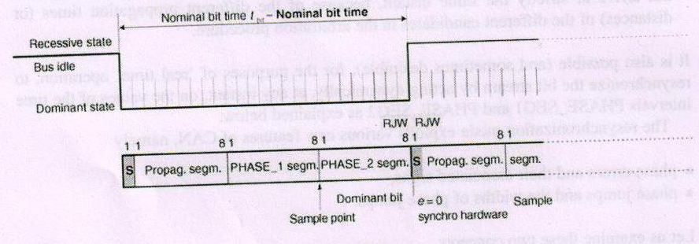
Contd.

Slide 97
|e| > RJW
If e is positive and greater than the RJW, there will be a ‘resynchronization’ of the nominal bit time by elongation of phase segment 1, which in this case will be increased by a quantity equal to the RJW
e is negative and greater than the RJW, there will be a ‘resynchronization’ of the nominal bit time by a shortening of phase segment 2, which in this case will be decreased by a quantity equal to the RJW
As shown above, the effect of the resynchronization operation makes it possible to reset the sample point to the most suitable moment of the incoming bit, to measure it with greater Accuracy.

Slide 98
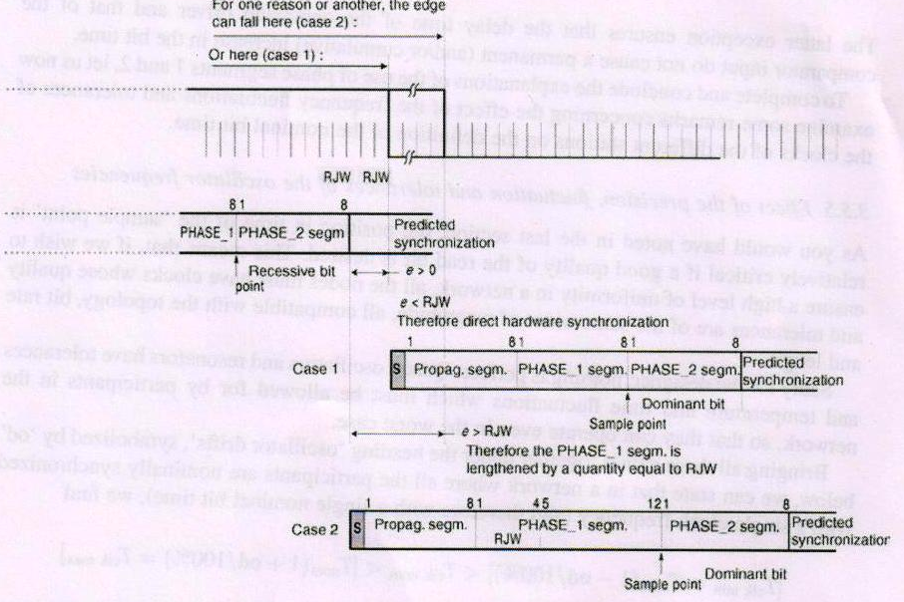
Contd.

Slide 99
Contd.
The amount of change in the phase buffer segments has an upper bound given by the synchronization jump width (SJW). The SJW is programmable between 1 and 4, and its value is added to Phase_Seg1 or subtracted from Phase_Seg2.

Slide 100
PIC Microcontroller CAN Interface
some PIC microcontrollers (e.g., PIC18F258) have built-in CAN modules, which can simplify the design of CAN bus–based systems
Microcontrollers with no built-in CAN modules can also be used in CAN bus applications, but additional hardware and software are required, making the design costly and also more complex

Slide 101
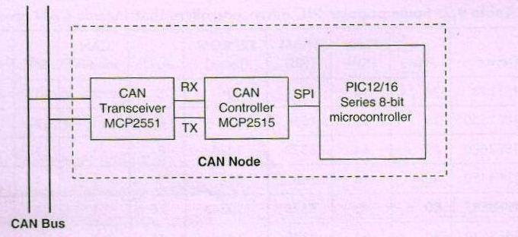
CAN node with any PIC microcontroller

Slide 102
Contd.
The microcontroller is connected to the CAN bus using an external MCP2515 CAN controller chip and an MCP2551 CAN bus transceiver chip.
This configuration is suitable for a quick upgrade to an existing design using any PIC microcontroller.

Slide 103
Contd.
For new CAN bus–based designs it is easier to use a PIC microcontroller with a built-in CAN module.
such devices include built-in CAN controller hardware on the chip.
All that is required to make a CAN node is to add a CAN transceiver chip.

Slide 104
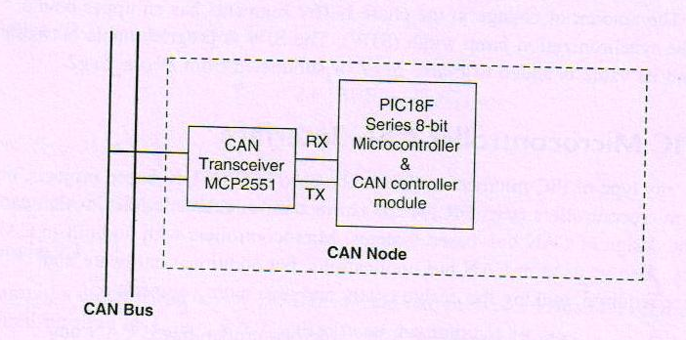
CAN node with integrated CAN module

Slide 105
PIC18F258 Microcontroller
The PIC18F258 is a high performance 8-bit microcontroller with integrated CAN module. The device has the following features:
32K flash program memory
1536 bytes RAM data memory
256 bytes EEPROM memory
22 I/O ports
5-channel 10-bit A/D converters
Three timers/counters
Three external interrupt pins
High-current (25mA) sink/source
Capture/compare/PWM module

Slide 106
Contd.
SPI/I2C module
CAN 2.0A/B module
Power-on reset and power-on timer
Watchdog timer
Priority level interrupts
DC to 40MHz clock input
8 8 hardware multiplier
Wide operating voltage (2.0V to 5.5V)
Power-saving sleep mode

Slide 107
Contd.
The features of the PIC18F258 microcontroller’s CAN module are as follows
Compatible with CAN 1.2, CAN 2.0A, and CAN 2.0B
Supports standard and extended data frames
Programmable bit rate up to 1Mbit/s
Double-buffered receiver
Three transmit buffers
Two receive buffers
Programmable clock source

Slide 108
Contd.
Six acceptance filters
Two acceptance filter masks
Loop-back mode for self-testing
Low-power sleep mode
Interrupt capabilities

Slide 109
Contd.
The CAN module uses port pins RB3/CANRX and RB2/CANTX for CAN bus receive and transmit functions respectively. These pins are connected to the CAN bus via an MCP2551-type CAN bus transceiver chip

Slide 110
Contd.
The PIC18F258 microcontroller supports the following frame types:
Standard data frame
Extended data frame
Remote frame
Error frame
Overload frame
Interframe space

Slide 111
Contd.
A node uses filters to decide whether or not to accept a received message.
Message filtering is applied to the whole identifier field, and mask registers are used to specify which bits in the identifier the filters should examine

Slide 112
Contd.
The CAN module in the PIC18F258 microcontroller has six modes of operation:
Configuration mode
Disable mode
Normal operation mode
Listen-only mode
Loop-back mode
Error recognition mode

Slide 113
Configuration Mode
The CAN module is initialized in configuration mode.
The module is not allowed to enter configuration mode while a transmission is taking place.
In configuration mode the module will neither transmit nor receive, the error counters are cleared, and the interrupt flags remain unchanged

Slide 114
Disable Mode
In disable mode, the module will neither transmit nor receive.
In this mode the internal clock is stopped unless the module is active. If the module is active, it will wait for 11 recessive bits on the CAN bus, detect that condition as an IDLE bus, and then accept the module disable command.
The WAKIF interrupt (wake-up interrupt) is the only CAN module interrupt that is active in disable mode.

Slide 115
Normal Operation Mode
The normal operation mode is the CAN module’s standard operating mode.
In this mode, the module monitors all bus messages and generates acknowledge bits, error frames, etc. This is the only mode that can transmit messages

Slide 116
Listen-only Mode
The listen-only mode allows the CAN module to receive messages, including messages with errors.
It can be used to monitor bus activities or to detect the baud rate on the bus. For automatic baud rate detection, at least two other nodes must be communicating with each other

Slide 117
The baud rate can be determined by testing different values until valid messages are received. The listen-only mode cannot transmit messages.

Slide 118
Loop-Back Mode
In the loop-back mode, messages can be directed from internal transmit buffers to receive buffers without actually transmitting messages on the CAN bus.
This mode is useful during system developing and testing.

Slide 119
Error Recognition Mode
The error recognition mode is used to ignore all errors and receive all messages.
In this mode, all messages, valid or invalid are received and copied to the receive buffer.

Slide 120
CAN Message Transmission
The PIC18F258 microcontroller implements three dedicated transmit buffers: TXB0, TXB1, and TXB2. Pending transmittable messages are in a priority queue.
Before the SOF is sent, the priorities of all buffers queued for transmission are compared.
The transmit buffer with the highest priority is sent first. If two buffers have the same priority, the one with the higher buffer number is sent first.
There are four levels of priority

Slide 121
CAN Message Reception
Reception of a message is a more complex process.
The PIC18F258 microcontroller includes two receive buffers, RXB0 and RXB1, with multiple acceptance filters for each
All received messages are assembled in the message assembly buffer (MAB).
Once a message is received, regardless of the type of identifier and the number of data bytes, the entire message is copied into the MAB

Slide 122
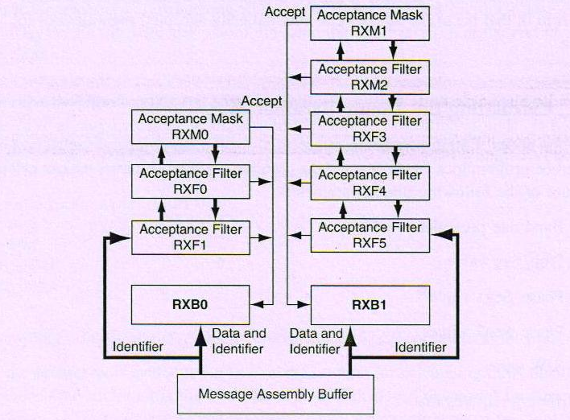
Receiver buffer

Slide 123
Contd.
Received messages have priorities. RXB0 is the higher priority buffer, and it has two message acceptance filters, RXF0 and RXF1.
RXB1 is the lower priority buffer and has four acceptance filters: RXF2, RXF3, RXF4, and RXF5.
Two programmable acceptance filter masks, RXM0 and RXM1, are also available, one for each receive buffer.

Slide 124
Contd.
The CAN module uses message acceptance filters and masks to determine if a message in the MAB should be loaded into a receive buffer.
Once a valid message is received by the MAB, the identifier field of the message is compared to the filter values.
If there is a match, that message is loaded into the appropriate receive buffer.
The filter masks determine which bits in the identifier are examined with the filters

Slide 125
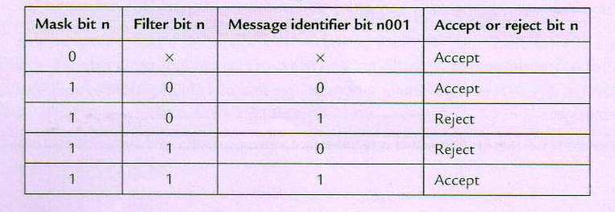
Filter truth table

Slide 126
Calculating the Timing Parameters
Baud rate prescaler value
Prop_Seg value
Phase_Seg1 value
Phase_Seg2 value
SJW value

Slide 127
Correct timing requires that
Prop_Seg þ Phase_Seg1 Phase_Seg2
Phase_Seg2 SJW

Slide 128
mikroC CAN Functions
The following mikroC functions are provided:
CANSetOperationMode
CANGetOperationMode
CANInitialize
CANSetBaudRAte
CANSetMask
CANSetFilter
CANRead
CANWrite

Slide 129
The CANSetOperationMode function sets the CAN operation mode. The function
prototype is:
void CANSetOperationMode(char mode, char wait_flag)
The parameter wait_ flag is either 0 or 0 FF. If it is set to 0 FF, the function blocks
and will not return until the requested mode is set. If it is set to 0, the function returns as
a nonblocking call.
The mode can be one of the following:
CAN_MODE_NORMAL Normal mode of operation
CAN_MODE_SLEEP Sleep mode of operation
CAN_MODE_LOOP Loop-back mode of operation

Slide 130
Contd.
CAN_MODE_LISTEN Listen-only mode of operation
CAN_MODE_CONFIG Configuration mode of operation

Slide 131
CANGetOperationMode
The CANGetOperationMode function returns the current CAN operation mode. The
function prototype is:
char CANGetOperationMode(void)

Slide 132
CANInitialize
The CANInitialize function initializes the CAN module. All mask registers are cleared
to 0 to allow all messages. Upon execution of this function, the normal mode is set. The
function prototype is:
void CANInitialize(char SJW, char BRP, char PHSEG1, char PHSEG2,
char PROPEG, char CAN_CONFIG_FLAGS)
where
SJW is the synchronization jump width
BRP is the baud rate prescaler
PHSEG1 is the Phase_Seg1 timing parameter
PHSEG2 is the Phase_Seg2 timing parameter
PROPSEG is the Prop_Seg
CAN_CONFIG_FLAGS can be one of the following configuration flags

Slide 133
CAN_CONFIG_DEFAULT Default flags
CAN_CONFIG_PHSEG2_PRG_ON Use supplied PHSEG2 value
CAN_CONFIG_PHSEG2_PRG_OFF Use maximum of PHSEG1 or
information processing time (IPT),
whichever is greater
CAN_CONFIG_LINE_FILTER_ON Use CAN bus line filter for wake-up
CAN_CONFIG_FILTER_OFF Do not use CAN bus line filter

Slide 134
CAN_CONFIG_SAMPLE_ONCE Sample bus once at sample point
CAN_CONFIG_SAMPLE_THRICE Sample bus three times prior to
sample point
CAN_CONFIG_STD_MSG Accept only standard identifier
messages
CAN_CONFIG_XTD_MSG Accept only extended identifier
messages
CAN_CONFIG_DBL_BUFFER_ON Use double buffering to receive
data

Slide 135
CAN_CONFIG_DBL_BUFFER_OFF Do not use double buffering
CAN_CONFIG_ALL_MSG Accept all messages including
invalid ones
CAN_CONFIG_VALID_XTD_MSG Accept only valid extended
identifier messages
CAN_CONFIG_VALID_STD_MSG Accept only valid standard
identifier messages
CAN_CONFIG_ALL_VALID_MSG Accept all valid messages

Slide 136
CANSetBaudRate
The CANSetBaudRate function is used to set the CAN bus baud rate. The function
prototype is:
void CANSetBaudRate(char SJW, char BRP, char PHSEG1, char PHSEG2,
char PROPSEG, char CAN_CONFIG_FLAGS)
The arguments of the function are as in function CANInitialize.

Slide 137
CANSetMask
The CANSetMask function sets the mask for filtering messages
void CANSetMask(char CAN_MASK, long value, char
CAN_CONFIGFLAGS)
CAN_MASK can be one of the following:
CAN_MASK_B1 Receive buffer 1 mask value
CAN_MASK_B2 Receive buffer 2 mask value
value is the mask register value. CAN_CONFIG_FLAGS can be either
CAN_CONFIG_XTD (extended message), or CAN_CONFIG_STD (standard
message).

Slide 138
CANSetFilter
The CANSetFilter function sets filter values. The function prototype is:
void CANSetFilter(char CAN_FILTER, long value, char
CAN_CONFIG_FLAGS)
CAN_FILTER can be one of the following:
CAN_FILTER_B1_F1 Filter 1 for buffer 1
CAN_FILTER_B1_F2 Filter 2 for buffer 1
CAN_FILTER_B2_F1 Filter 1 for buffer 2
CAN_FILTER_B2_F2 Filter 2 for buffer 2
CAN_FILTER_B2_F3 Filter 3 for buffer 2
CAN_FILTER_B2_F4 Filter 4 for buffer 2
CAN_CONFIG_FLAGS can be either CAN_CONFIG_XTD (extended message) or
CAN_CONFIG_STD (standard message).

Slide 139
CANRead
The CANRead function is used to read messages from the CAN bus. If no message is
available, 0 is returned. The function prototype is:
char CANRead(long *id, char *data, char *datalen, char
*CAN_RX_MSG_FLAGS)

Slide 140
CAN_RX_MSG_FLAGS can be one of the following:
CAN_RX_FILTER_1 Receive buffer filter 1 accepted this message
CAN_RX_FILTER_2 Receive buffer filter 2 accepted this message
CAN_RX_FILTER_3 Receive buffer filter 3 accepted this message
CAN_RX_FILTER_4 Receive buffer filter 4 accepted this message
CAN_RX_FILTER_5 Receive buffer filter 5 accepted this message
CAN_RX_FILTER_6 Receive buffer filter 6 accepted this message
CAN_RX_OVERFLOW Receive buffer overflow occurred
CAN_RX_INVALID_MSG Invalid message received
CAN_RX_XTD_FRAME Extended identifier message received
CAN_RX_RTR_FRAME RTR frame message received
CAN_RX_DBL_BUFFERED This message was double buffered

Slide 141
CANWrite
The CANWrite function is used to send a message to the CAN bus. A zero is returned
if message can not be queued (buffer full). The function prototype is:
char CANWrite(long id, char *data, char datalen, char
CAN_TX_MSG_FLAGS)
id is the CAN message identifier. Only 11 or 29 bits may be used depending on message
type (standard or extended). data is an array of bytes up to 8 where the data to be sent is
stored. datalen is the length of the data (1 to 8)

Slide 142
CAN_TX_MSG_FLAGS can be one of the following:
CAN_TX_PRIORITY_0 Transmit priority 0
CAN_TX_PRIORITY_1 Transmit priority 1
CAN_TX_PRIORITY_2 Transmit priority 2
CAN_TX_PRIORITY_3 Transmit priority 3
CAN_TX_STD_FRAME Standard identifier message
CAN_TX_XTD_FRAME Extended identifier message
CAN_TX_NO_RTR_FRAME Non RTR message
CAN_TX_RTR_FRAME RTR message
These flags can be bitwise AND’ed if desired.

Slide 143
CAN Bus Programming
Configure the CAN bus I/O port directions (RB2 and RB3)
Initialize the CAN module (CANInitialize)
Set the CAN module to CONFIG mode (CANSetOperationMode)
Set the mask registers (CANSetMask)
Set the filter registers (CANSetFilter)
Set the CAN module to normal mode (CANSetOperationMode)
Write/read data (CANWrite/CANRead)

Slide 144
Temperature Sensor CAN Bus Project
The system is made up of two CAN nodes.
One node (called DISPLAY node) requests the temperature every second and displays it on an LCD. This process is repeated continuously.
The other node (called COLLECTOR node) reads the temperature from an external semiconductor temperature sensor.

Slide 145
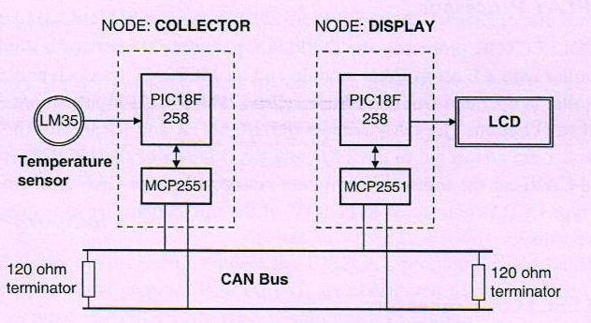
Temperature Sensor CAN Bus Project

Slide 146
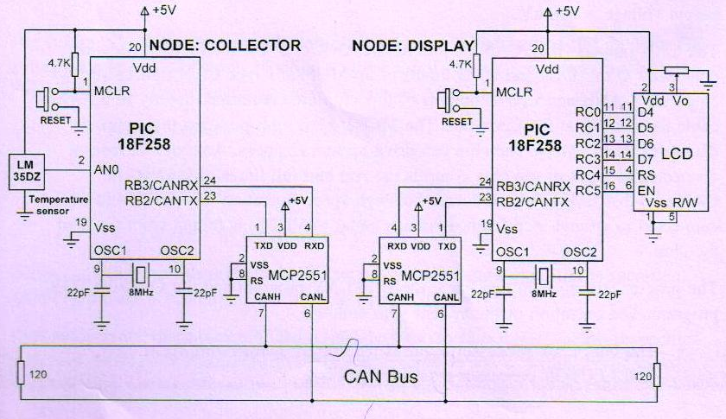
Contd.

Slide 147
Contd.
Two CAN nodes are connected together using a two-meter twisted pair cable, terminated with a 120-ohm resistor at each end

Slide 148
The DISPLAY Processor
Like the COLLECTOR processor, the DISPLAY processor consists of a PIC18F258 microcontroller with a built-in CAN module and an MCP2551 transceiver chip.
The microcontroller is operated from an 8MHz crystal. The MCLR input is connected to an external reset button.
The CAN outputs (RB2/CANTX and RB3/CANRX) of the microcontroller are connected to the TXD and RXD inputs of the MCP2551.
Pins CANH and CANL of the transceiver chip are connected to the CAN bus.
An HD44780-type LCD is connected to PORTC of the microcontroller to display the temperature values.

Slide 149
The COLLECTOR Processor
The COLLECTOR processor consists of a PIC18F258 microcontroller with a built-in CAN module and an MCP2551 transceiver chip.
The microcontroller is operated from an 8MHz crystal.
The MCLR input is connected to an external reset button.
Analog input AN0 of the microcontroller is connected to a LM35DZ-type semiconductor temperature sensor.
The sensor can measure temperature in the range of 0C to 100C and generates an analog voltage directly proportional to the measured temperature (i.e., the output is 10mV/C). For example, at 20C the output voltage is 200mV.

Slide 150
Contd.
The CAN outputs (RB2/CANTX and RB3/CANRX) of the microcontroller are connected to the TXD and RXD inputs of an MCP2551-type CAN transceiver chip.
The CANH and CANL outputs of this chip are connected directly to a twisted cable terminating at the CAN bus

Slide 151
Contd.
The MCP2551 is an 8-pin chip that supports data rates up to 1Mb/s. The chip can drive up to 112 nodes.
An external resistor connected to pin 8 of the chip controls the rise and fall times of CANH and CANL so that EMI can be reduced.
For high-speed operation this pin should be connected to ground.
A reference voltage equal to VDD/2 is output from pin 5 of the chip.
The program listing is in two parts: the DISPLAY program and the COLLECTOR program.
The operation of the system is as follows:
The DISPLAY processor requests the current temperature from the
COLLECTOR processor over the CAN bus

Slide 152
Contd.
The COLLECTOR processor reads the temperature, formats it, and sends to the DISPLAY processor over the CAN bus
The DISPLAY processor reads the temperature from the CAN bus and then displays it on the LCD
This process is repeated every second

Slide 153
DISPLAY Program
PORTC pins are configured as outputs, RB3 is configured as input (CANRX), and RB2 is configured as output (CANTX).
CAN bus bit rate =100Kb/s.
microcontroller clock frequency = 8MHz, the Baud Rate Calculator program
SJW = 1
BRP = 1
Phase_Seg1 = 6
Phase_Seg2 = 7
Prop_Seg = 6

Slide 154
Contd.
CANInitialize
init_flag = CAN_CONFIG_SAMPLE_THRICE &
CAN_CONFIG_PHSEG2_PRG_ON &
CAN_CONFIG_STD_MSG &
CAN_CONFIG_DBL_BUFFER_ON &
CAN_CONFIG_VALID_XTD_MSG &
CAN_CONFIG_LINE_FILTER_OFF;
filter masks and filter values are specified are set to all 1’s

Slide 155
Contd.
void main()
{
unsigned char temperature, data[8];
unsigned short init_flag, send_flag, dt, len, read_flag;
char SJW, BRP, Phase_Seg1, Phase_Seg2, Prop_Seg, txt[4];
long id, mask;

Slide 156
Contd.
TRISC = 0; // PORTC are outputs (LCD)
TRISB = 0x08; // RB2 is output, RB3 is input
// CAN BUS Parameters
SJW = 1;
BRP = 1;
Phase_Seg1 = 6;
Phase_Seg2 = 7;
Prop_Seg = 6;
init_flag = CAN_CONFIG_SAMPLE_THRICE &

Slide 157
Contd.
CAN_CONFIG_PHSEG2_PRG_ON &
CAN_CONFIG_STD_MSG &
CAN_CONFIG_DBL_BUFFER_ON &
CAN_CONFIG_VALID_XTD_MSG &
CAN_CONFIG_LINE_FILTER_OFF;
send_flag = CAN_TX_PRIORITY_0 &
CAN_TX_XTD_FRAME &
CAN_TX_NO_RTR_FRAME;
read_flag = 0;

Slide 158
Contd.
// Initialize CAN module
CANInitialize(SJW, BRP, Phase_Seg1, Phase_Seg2, Prop_Seg, init_flag);
// Set CAN CONFIG mode
CANSetOperationMode(CAN_MODE_CONFIG, 0xFF);
mask = -1;
// Set all MASK1 bits to 1's
CANSetMask(CAN_MASK_B1, mask, CAN_CONFIG_XTD_MSG);
// Set all MASK2 bits to 1's

Slide 159
Contd.
CANSetMask(CAN_MASK_B2, mask, CAN_CONFIG_XTD_MSG);
// Set id of filter B2_F3 to 3
CANSetFilter(CAN_FILTER_B2_F3,3,CAN_CONFIG_XTD_MSG);
// Set CAN module to NORMAL mode
CANSetOperationMode(CAN_MODE_NORMAL, 0xFF);

Slide 160
Contd.
//Configure LCD
Lcd_Config(&PORTC,4,5,0,3,2,1,0); // LCD is connected to PORTC
Lcd_Cmd(LCD_CLEAR); // Clear LCD
Lcd_Out(1,1,"CAN BUS"); // Display heading on LCD
Delay_ms(1000); // Wait for 2 seconds
// Program loop. Read the temperature from Node:COLLECTOR and display // on the LCD continuously
//

Slide 161
Contd.
for(;;) // Endless loop
{
Lcd_Cmd(LCD_CLEAR); // Clear LCD
Lcd_Out(1,1,"Temp = "); // Display "Temp = “
// Send a message to Node:COLLECTOR and ask for data
data[0] = 'T'; // Data to be sent
id = 500; // Identifier
CANWrite(id, data, 1, send_flag); // send 'T'

Slide 162
Contd.
// Get temperature from node:COLLECT
dt = 0;
while(!dt)dt = CANRead(&id, data, &len, &read_flag);
if(id == 3)
{
temperature = data[0];
ByteToStr(temperature,txt); // Convert to string
Lcd_Out(1,8,txt); // Output to LCD
Delay_ms(1000); // Wait 1 second
}
}
}

Slide 163
Contd.
Filter 3 for buffer 2 is set to value 3 so that identifiers having values 3 are accepted by the receive buffer.
The operation mode is then set to NORMAL. The program then configures the LCD and displays the message “CAN BUS” for one second on the LCD.
The main program loop executes continuously and starts with a for statement.
Inside this loop the LCD is
Then character “T” is sent over the bus with the identifier equal to 500 (the COLLECTOR

Slide 164
Contd.
void main()
{
unsigned char temperature, data[8];
unsigned short init_flag, send_flag, dt, len, read_flag;
char SJW, BRP, Phase_Seg1, Phase_Seg2, Prop_Seg, txt[4];
unsigned int temp;
unsigned long mV;
long id, mask;

Slide 165
Contd.
TRISA = 0xFF; // PORTA are inputs
TRISB = 0x08; // RB2 is output, RB3 is input
// Configure A/D converter
ADCON1 = 0x80;

Slide 166
Contd.
// CAN BUS Timing Parameters
SJW = 1;
BRP = 1;
Phase_Seg1 = 6;
Phase_Seg2 = 7;
BRP = 1;
Prop_Seg = 6;
init_flag = CAN_CONFIG_SAMPLE_THRICE &
CAN_CONFIG_PHSEG2_PRG_ON &
CAN_CONFIG_STD_MSG &
CAN_CONFIG_DBL_BUFFER_ON &
CAN_CONFIG_VALID_XTD_MSG &
CAN_CONFIG_LINE_FILTER_OFF;

Slide 167
Contd.
send_flag = CAN_TX_PRIORITY_0 &
CAN_TX_XTD_FRAME &
CAN_TX_NO_RTR_FRAME;
read_flag = 0;
// Initialise CAN module
CANInitialize(SJW, BRP, Phase_Seg1, Phase_Seg2, Prop_Seg, init_flag);
// Set CAN CONFIG mode
CANSetOperationMode(CAN_MODE_CONFIG, 0xFF);
mask = -1;
// Set all MASK1 bits to 1's

Slide 168
Contd.
CANSetMask(CAN_MASK_B1, mask, CAN_CONFIG_XTD_MSG);
// Set all MASK2 bits to 1's
CANSetMask(CAN_MASK_B2, mask, CAN_CONFIG_XTD_MSG);
// Set id of filter B1_F1 to 3
CANSetFilter(CAN_FILTER_B2_F3,500,CAN_CONFIG_XTD_MSG);
// Set CAN module to NORMAL mode
CANSetOperationMode(CAN_MODE_NORMAL, 0xFF);

Slide 169
Contd.
// Program loop. Read the temperature from analog temperature
// sensor
for(;;) // Endless loop
{
// Wait until a request is received
dt = 0;
while(!dt) dt = CANRead(&id, data, &len, &read_flag);
if(id == 500 && data[0] == 'T')
{
// Now read the temperature

Slide 170
Contd.
temp = Adc_Read(0); // Read temp
mV = (unsigned long)temp ∗ 5000 / 1024; // in mV
temperature = mV/10; // in degrees C
// send the temperature to Node:Display
data[0] = temperature;
id = 3; // Identifier
CANWrite(id, data, 1, send_flag); // send temperature
}
}
}

Slide 171
Contd.
Node: DISPLAY Node: COLLECTOR
Initialize CAN module Initialize CAN module
Set mode to CONFIG Set mode to CONFIG
Set Mask bits to 1’s Set Mask bits to 1’s
Set Filter value to 3 Set Filter value to 500
Set mode to NORMAL Set mode to NORMAL
DO FOREVER DO FOREVER
Send character “T” with identifier 500 Read a character
Read temperature with identifier 3 IF character is “T”
Convert temperature to string Read temperature
Display temperature on LCD Convert to digital
Wait 1 second Convert to ºC
ENDDO Send with identifier 3
ENDIF
ENDDO

